Slide 1

Modeling a 4-Way Intersection During Rush Hour
Group 9
Aidan Calderhead
Enrique Rosen
Peter Salem
Aedhan Scott

Slide 2
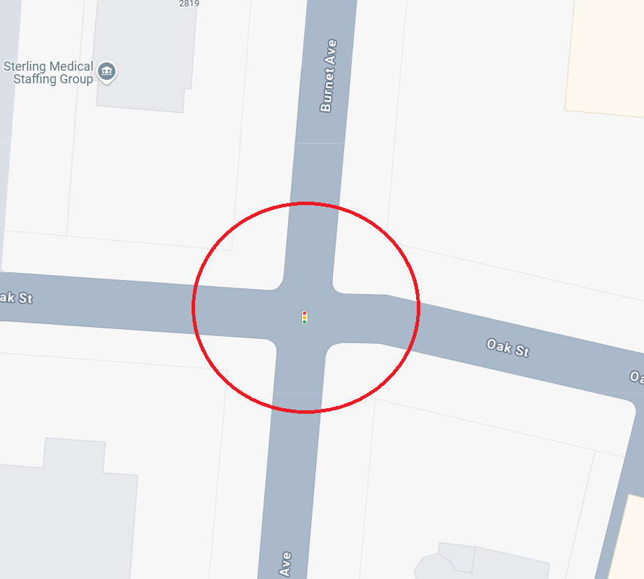
Our Model:
S
Goal: Obtain and use traffic arrival data to decrease waiting times for cars at this intersection.
System: 4-Way Intersection at Oak & Burnett off I-71S exit 3A
W
E
N

Slide 3
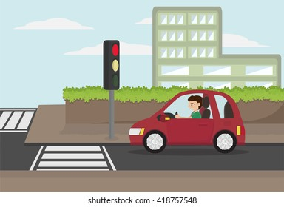
Why We Chose This Intersection:
This intersection is part of the route home for one of our group members
They are often stuck waiting for the light to change when no other cars are even around
Notes:
This specific intersection is on the route home for one of our group members. It is an often occurrence that one is stuck waiting in the intersection when there are no other cars around. This suggests there is room for improvement in the signal timing for the traffic lights.

Slide 4
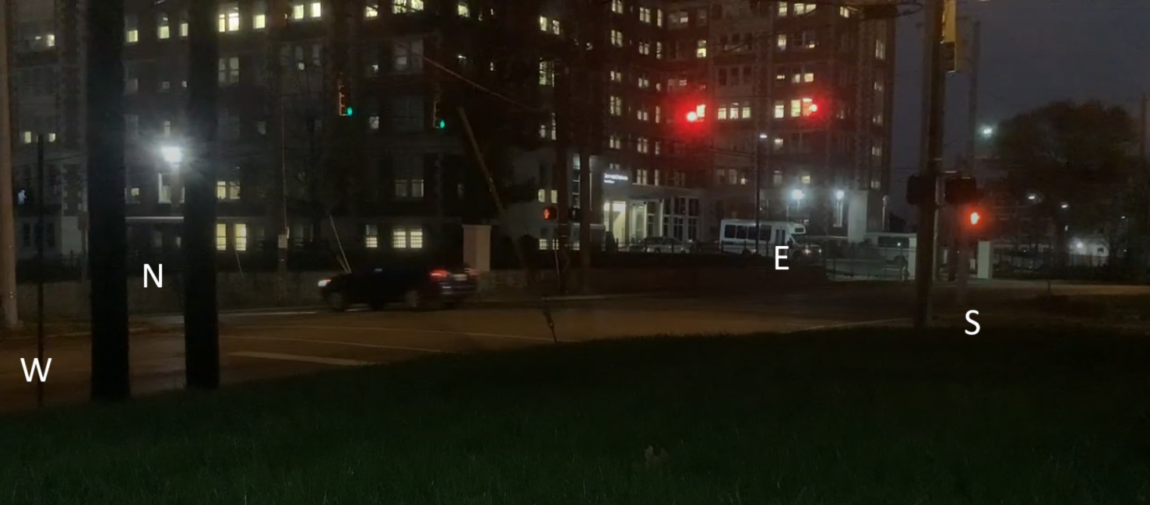
Data Collection:
The intersection was recorded from 6 – 7 PM on a Monday evening.
801 cars were recorded driving through the intersection during this time.
-292 from the north
-86 from the west
-329 from the south
-94 from the east
Oak & Burnett at 6PM

Slide 5
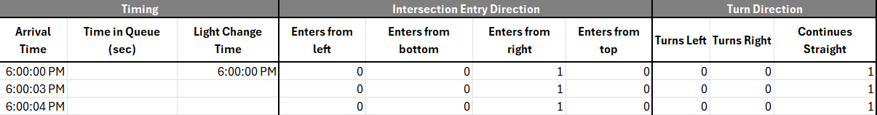
Data Entry / Cleaning:
Arrival Time: When the car arrived at the intersection
Time in Queue: How long the car waited before it could continue (blank is 0)
Light Change: The time when the green light changes
Which direction the car enters the intersection from
Which direction the car goes in the intersection (turns left, right, or continues straight)

Slide 6

Modeling Relevant Distributions:
North-south light time
East-west light time
Car arrivals from the west
Car arrivals from the east
Car arrivals from the north
Car arrivals from the south

Slide 7
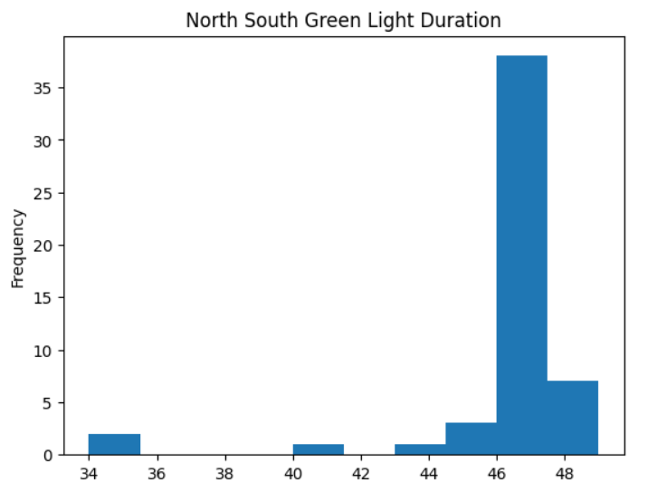
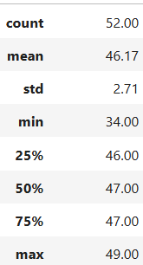
North-South Light Time
Found to be essentially constant, at 46 seconds for a green light going north to south
Any variation was found to be minor, or explainable by potential unknowns that we were not able to account for, such as traffic sensors or custom timings

Slide 8
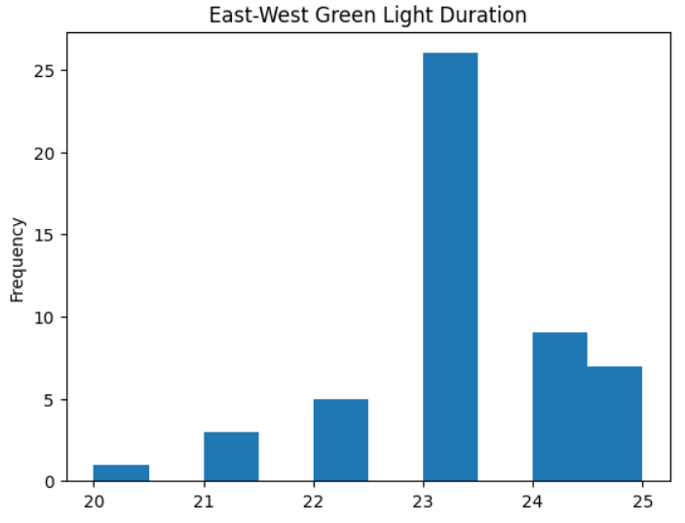
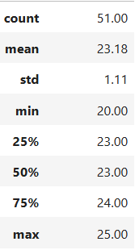
East-West Light Time
Found to be essentially constant, at 23 seconds for a green light going east-west.
Similarly to North-South, variation was minor or could be explained by potential unknowns that cannot be accounted for, such as traffic sensors or hardcoded timings.

Slide 9
Light Cycle Time
Defined as the time for a complete traffic light cycle
= (North-South Light Time) + (East West Light Time)
= Constant(46) + Constant(23) = Constant(69) seconds
(North South Light Time) per (East West Light Time) was found to be a ratio of 2:1

Slide 10
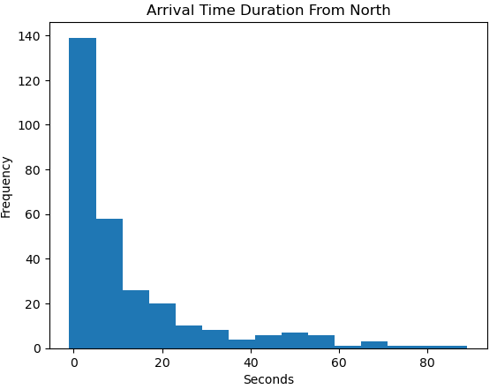
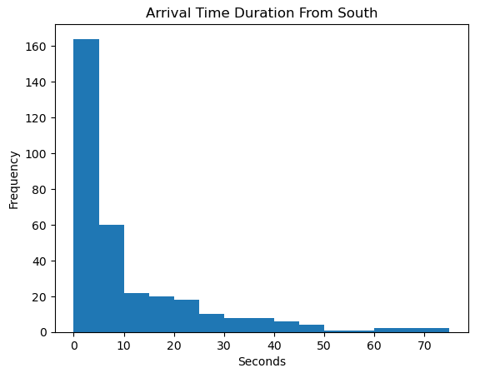
Car Arrivals: North and South
Arrivals from the north and south each had highly similar distributions
(Distribution Type: BETA/LOGNORMAL)
(Distribution Type: BETA/LOGNORMAL)

Slide 11
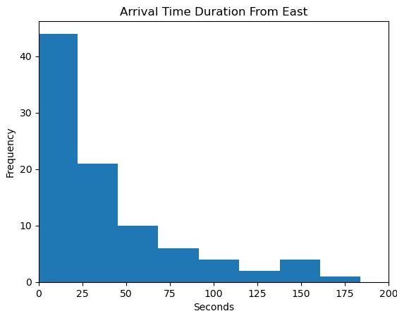
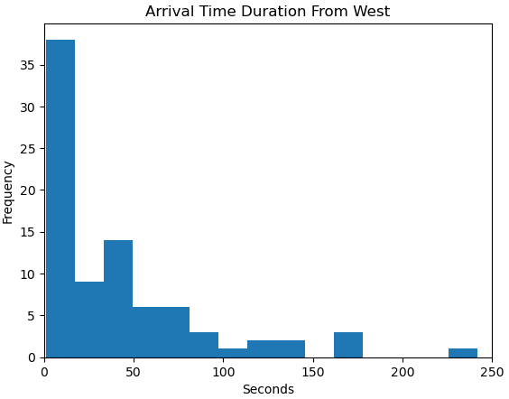
Car Arrivals: East and West
Arrivals from the east and west each had highly similar distributions as well, but much longer arrival times on average vs north/south
(Distribution Type: EXPONENTIAL/GAMMA)
(Distribution Type: EXPONENTIAL/GAMMA)

Slide 12
Modeling the Intersection
S
Quadrants are the key to a driver's path through the intersection!
W
E
N

Slide 13
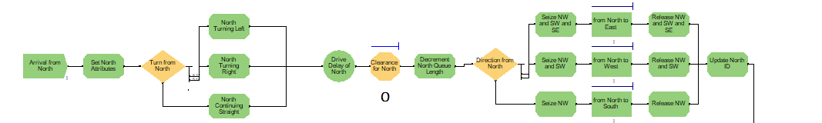
The Model: Northside Arrivals
Cars arrive from the north, and their intended path is determined.
Cars wait for the right-of-way.
Once they have the right-of-way, the proceed through their path in the intersection.

Slide 14
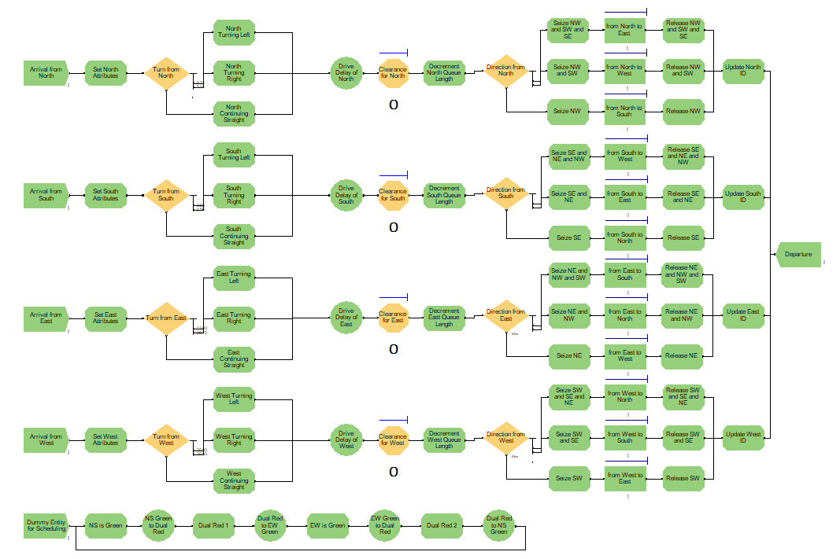
The Model: Completed

Slide 15
Model Results:
Across 100 replications and a run length of 1 hour, an average of 649 vehicles passing through the intersection, and the average waiting time of all cars at this intersection was found to be 7.7 seconds.
Or, 4.8 seconds for North-South cars and 15.8 seconds for East-West cars
Notes:
This wait time makes sense intuitively because if the north-south traffic signal is green, cars arriving east-west could conceivably wait up to 46 seconds for the light to change. Conversely, east-west cars could wait up to 23 seconds for the light to change. This, plus time waiting to be able to make a left turn or time waiting for the car ahead of you in queue to start moving would also add to the wait time.

Slide 16
Changing The Light Timings:
From our data, we found that 621 cars arrived from the north and south during rush hour, but only 180 arrived from the east and west for a ratio of 3.45:1.
The current traffic signal timings are 2:1 (North-South : East-West) over the course of a 69 second traffic cycle.
We tried changing the traffic cycle timings to mirror those of the proportion of car arrivals, resulting in 53.5 seconds for north-south and 15.5 seconds for east-west.

Slide 17
Updated Model Results:
Recall: we changed the light timings to be 53.5s and 15.5s for north-south and east-west, respectively.
Running the updated model with the same simulation parameters of 100 replications with a run length of 1 hour, waiting time for cars in queue decreased to 7.3 seconds (a 0.4 second decrease (5.2% change)).
Or, 2.4 seconds waiting for North-South cars, and 20.8 seconds for East-West cars. We find that the average waiting time for North-South cars decreased by 2.6 seconds white it increased by 5 seconds for East-West cars.

Slide 18
Recommendations:
Old Model Wait Time: 7.7s, New Model Wait Time: 7.3s
This is a decrease of 0.4 seconds from the previous model, or a 5.2% decrease overall
While not a huge decrease, the data supports that our model can serve as an upgrade over the original, reducing wait times by over 5%. We recommend that the Light signal timings at Burnett and Oak be changed to match our new models.

